Slide 1
Inspector calls key scene analysis
Vitus Luo and Jerry Yuan

Slide 2

The main plot
During the gorgeous dinner that decided the engagement of Gerald and Sheilla, the bell rings and the maid Edna goes to open it. An inspector called Goole who wears plain darkish clothes of the period makes a visit. Because Mr. Birling is still on the bench, he thinks that the inspector is just applying for a warrant. However, it’s not. Goole the inspector shows his purpose of making this visit: asking for some information about a woman who committed a suicide. She had worked in Mr. Birling’s firm before. Meantime, she seems not to be an ordinary worker and Mr. Birling supposed to know her. Then, the inspector shows Mr. Birling a photo of her. After admitting knowing her, he said that he discharges the women after a group she led ask for more wages two years ago. He thinks that the suicide has nothing to do with him. Nevertheless, the inspector thinks quite the reverse.

Slide 3


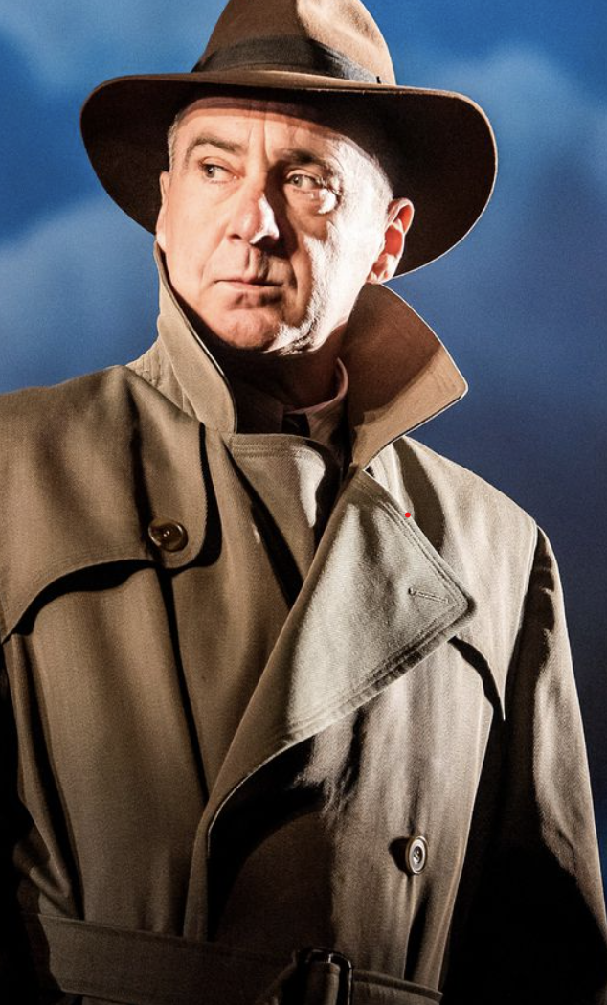
The main plot
During the gorgeous dinner that decided the engagement of Gerald and Sheilla, the bell rings and the maid Edna goes to open it. An inspector called Goole who wears plain darkish clothes of the period makes a visit. Because Mr. Birling is still on the bench, he thinks that the inspector is just applying for a warrant. However, it’s not. Goole the inspector shows his purpose of making this visit: asking for some information about a woman who committed a suicide. She had worked in Mr. Birling’s firm before. Meantime, she seems not to be an ordinary worker and Mr. Birling supposed to know her. Then, the inspector shows Mr. Birling a photo of her. After admitting knowing her, he said that he discharges the women after a group she led ask for more wages two years ago. He thinks that the suicide has nothing to do with him. Nevertheless, the inspector thinks quite the reverse.

Slide 4


The main plot
During the gorgeous dinner that decided the engagement of Gerald and Sheilla, the bell rings and the maid Edna goes to open it. An inspector called Goole who wears plain darkish clothes of the period makes a visit. Because Mr. Birling is still on the bench, he thinks that the inspector is just applying for a warrant. However, it’s not. Goole the inspector shows his purpose of making this visit: asking for some information about a woman who committed a suicide. She had worked in Mr. Birling’s firm before. Meantime, she seems not to be an ordinary worker and Mr. Birling supposed to know her. Then, the inspector shows Mr. Birling a photo of her. After admitting knowing her, he said that he discharges the women after a group she led ask for more wages two years ago. He thinks that the suicide has nothing to do with him. Nevertheless, the inspector thinks quite the reverse.

Slide 5


The main plot
During the gorgeous dinner that decided the engagement of Gerald and Sheilla, the bell rings and the maid Edna goes to open it. An inspector called Goole who wears plain darkish clothes of the period makes a visit. Because Mr. Birling is still on the bench, he thinks that the inspector is just applying for a warrant. However, it’s not. Goole the inspector shows his purpose of making this visit: asking for some information about a woman who committed a suicide. She had worked in Mr. Birling’s firm before. Meantime, she seems not to be an ordinary worker and Mr. Birling supposed to know her. Her name is Eva Smith. Then, the inspector shows Mr. Birling a photo of her. After admitting knowing her, he said that he discharges the women after a group she led ask for more wages two years ago. He thinks that the suicide has nothing to do with him. Nevertheless, the inspector thinks quite the reverse.

Slide 6
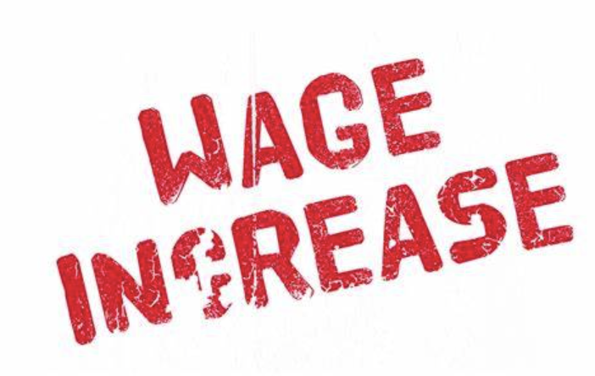
The main plot
During the gorgeous dinner that decided the engagement of Gerald and Sheilla, the bell rings and the maid Edna goes to open it. An inspector called Goole who wears plain darkish clothes of the period makes a visit. Because Mr. Birling is still on the bench, he thinks that the inspector is just applying for a warrant. However, it’s not. Goole the inspector shows his purpose of making this visit: asking for some information about a woman who committed a suicide. She had worked in Mr. Birling’s firm before. Meantime, she seems not to be an ordinary worker and Mr. Birling supposed to know her. Her name is Eva Smith. Then, the inspector shows Mr. Birling a photo of her. After admitting knowing her, he said that he discharges the women after a group she led ask for more wages two years ago. He thinks that the suicide has nothing to do with him. Nevertheless, the inspector thinks quite the reverse.

