Slide 1
CHAPTER
Separation and Purification
The following content has not been through the Cambridge Assessment International Education endorsement process.
1

Slide 2

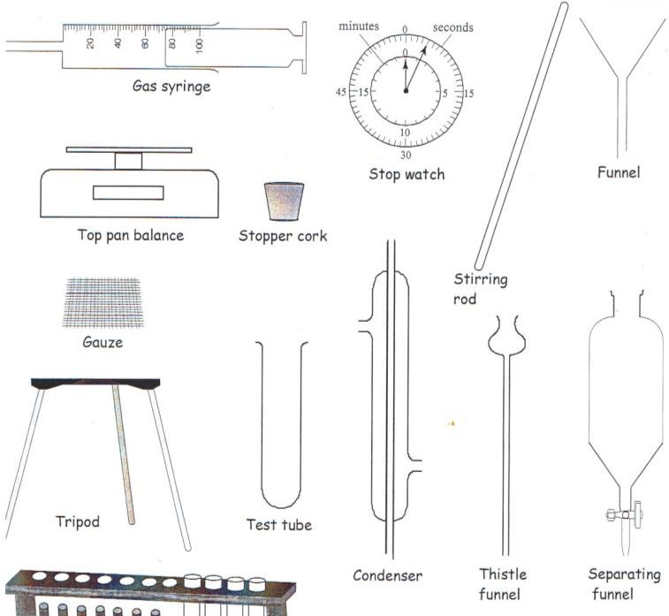
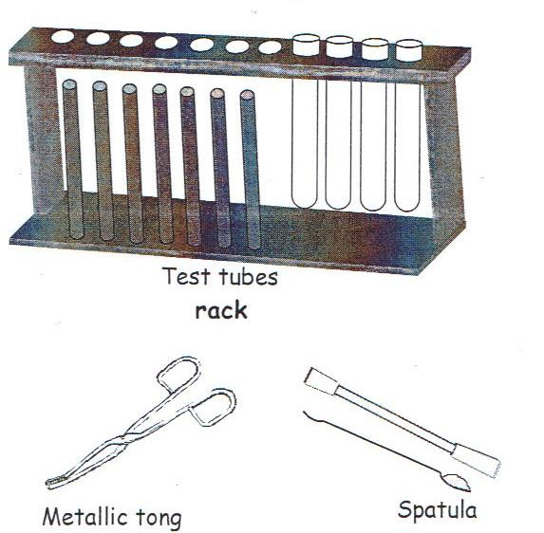
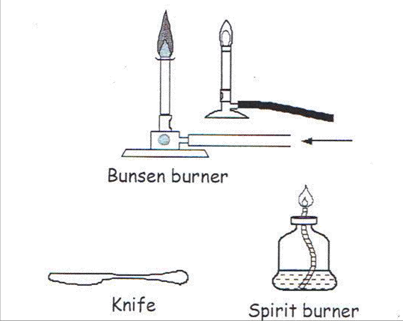
APPARATUS!!!

Slide 3
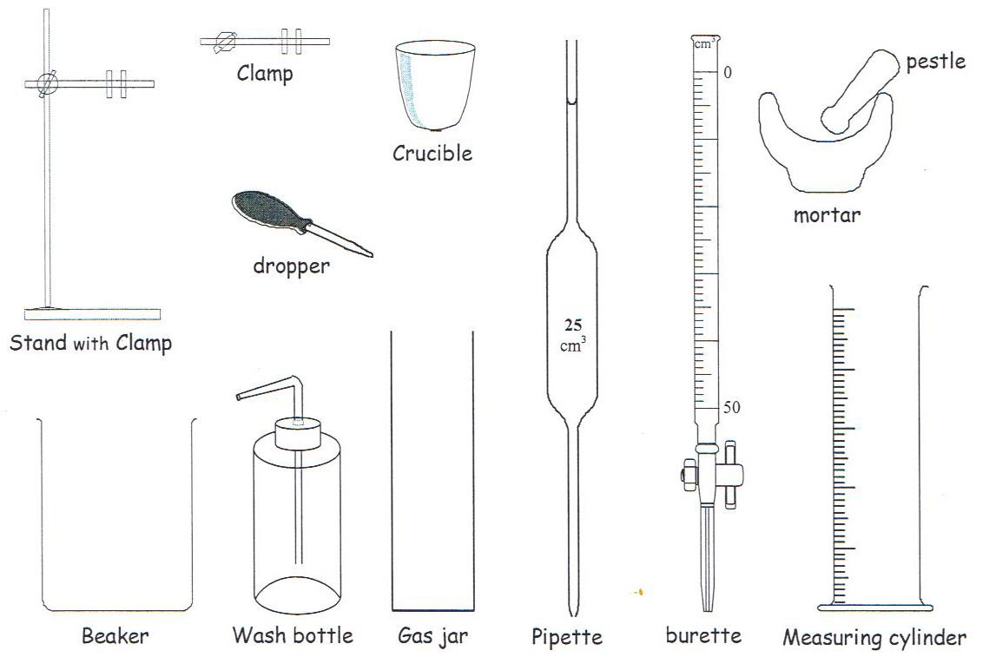
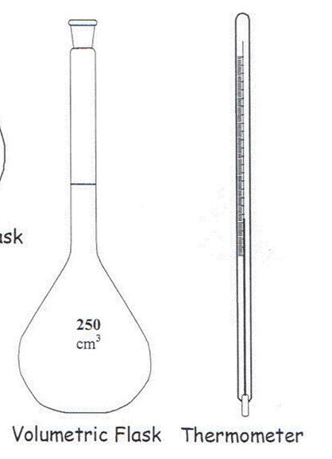
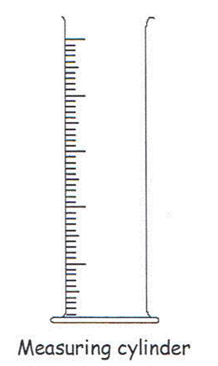
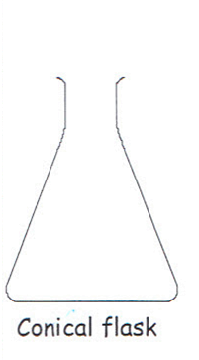
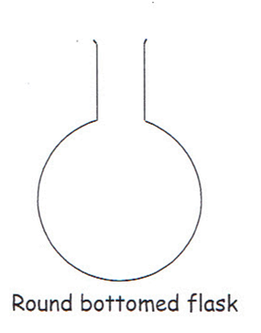
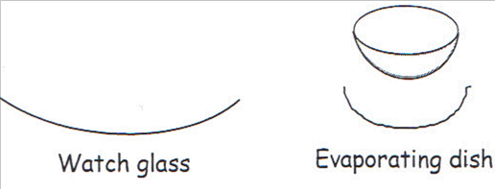
APPARATUS!!!

Slide 4
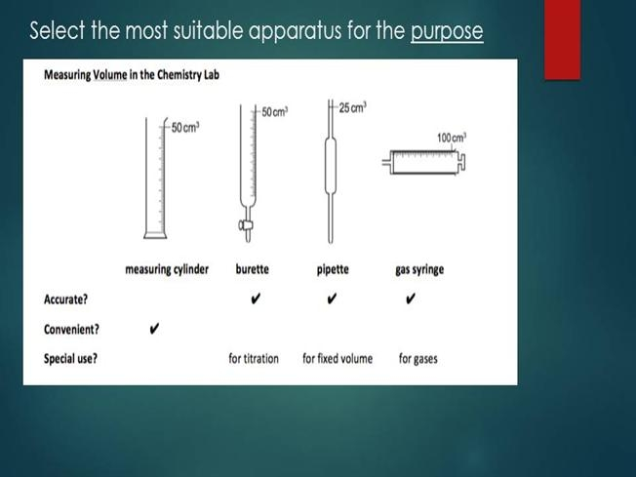






Slide 5
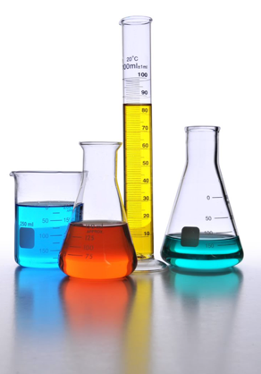
Questions
Name the pieces of apparatus shown in the picture on the previous slide. What are their uses?
What are some quantities that are commonly measured in experiments?
What are some safety precautions taken by the chemist?
Suggest the type of compounds that form the coloured mixtures.
5
Notes:
Use the chapter opener as a warm-up.
Ask students the questions shown.
Guide students if they have difficulties in answering the questions.

Slide 6
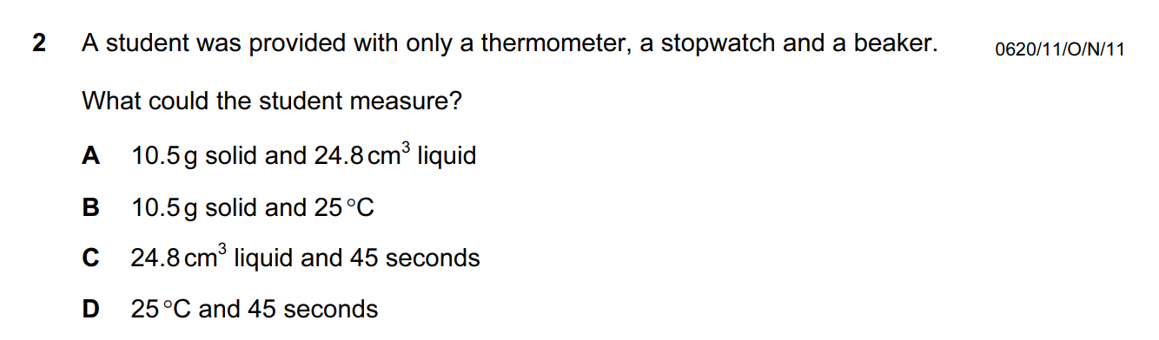
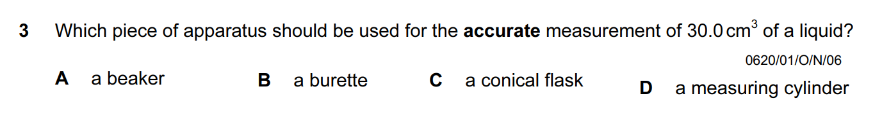



Slide 7
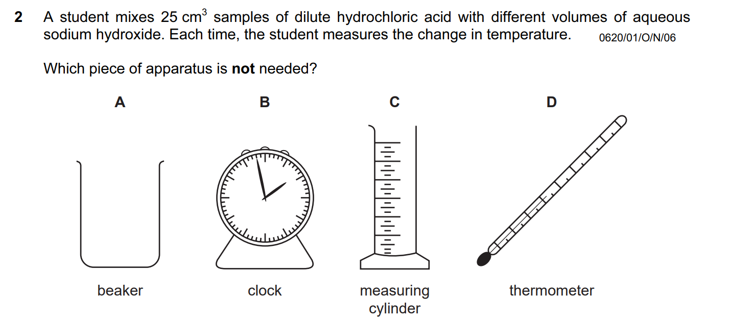

Slide 8
Common Terms Used in Experiments
In this section, you will learn the following:
Describe a solvent, solute, solution, saturated solution, residue and filtrate
8
Notes:
Outline the learning aim of the section.
Remind students that they will eventually integrate their learning and from connections between the concepts

Slide 9
Formation of copper(II) sulfate solution
9
Notes:
Show students the formation of copper(II) sulfate solution using the diagrams.
Highlight to them that copper(II) sulfate solution is a type of mixture and it is important to use the correct terms when describing mixtures.
Go through with students how we describe a solvent, solute and solution using the diagrams.

Slide 10
Examples of common solutions
10
Notes:
Encourage students to identify the solute and solvents from the four given solutions.

Slide 11
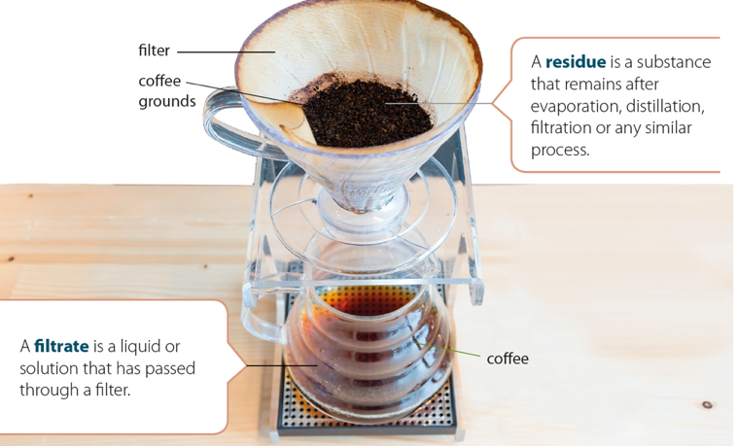
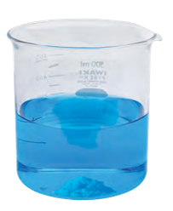
Saturated solution
A saturated solution is a solution containing the maximum concentration of a solute dissolved
in a solvent at a specified temperature
When more solute is added to a saturated solution, the solute will not dissolve.
11
Notes:
Explain to students what a saturated solution is.
Have students share how undissolved coffee grounds are separated from coffee.
Go through with students what filtrate and residue refer to using the diagram on the right.
Ask the students to discuss the other types of solutions that they encounter in their daily lives.

Slide 12
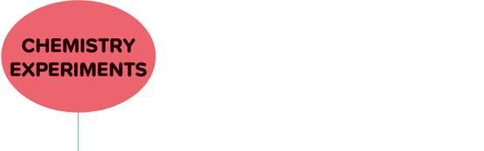
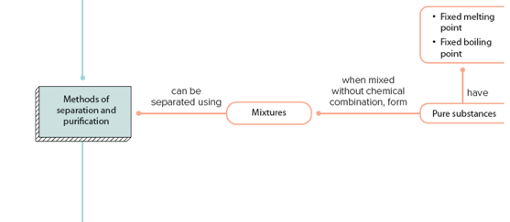
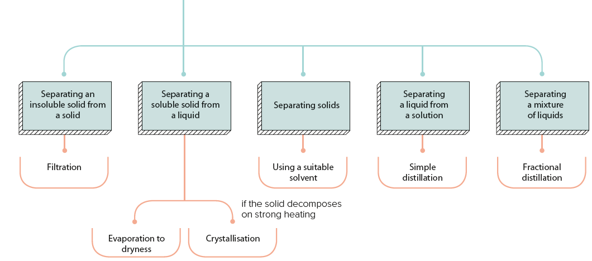
Separation and Purification
In this section, you will learn the following:
Describe and explain methods of separation and purification.
Suggest suitable separation and purification techniques, given information about the substances involved.
Identify substances and assess their purity using information on their melting and boiling points.
Filtration - YouTube
Separation of two immiscible liquids oil & Water using separating funnel chemistry demo | STD 7-10 - YouTube
12
Notes:
Outline the learning aims of the section.
Remind students that they will eventually integrate their learning and form connections between the concepts.

Slide 13
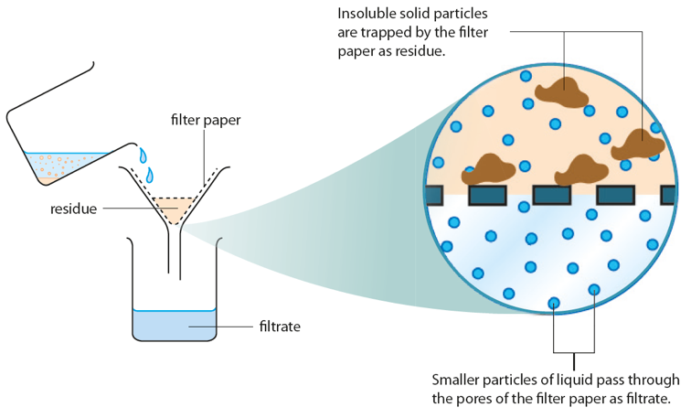
How can we separate a solid from a liquid?
1. Filtration
Filtration is used to separate insoluble solid particles from a liquid.
An insoluble solid can be separated from a liquid by filtration because the filter paper acts as a sieve. A liquid can pass through the pores (small holes) of the filter paper, but a solid cannot do so
How filtration works
13
Notes:
Relate this slide to slide 16 that used the brewing of coffee as an example.
Lead them to understand that filtration is used to separate a solid from a liquid.
Encourage students to define the terms filtration, filtrate and residue.

Slide 14
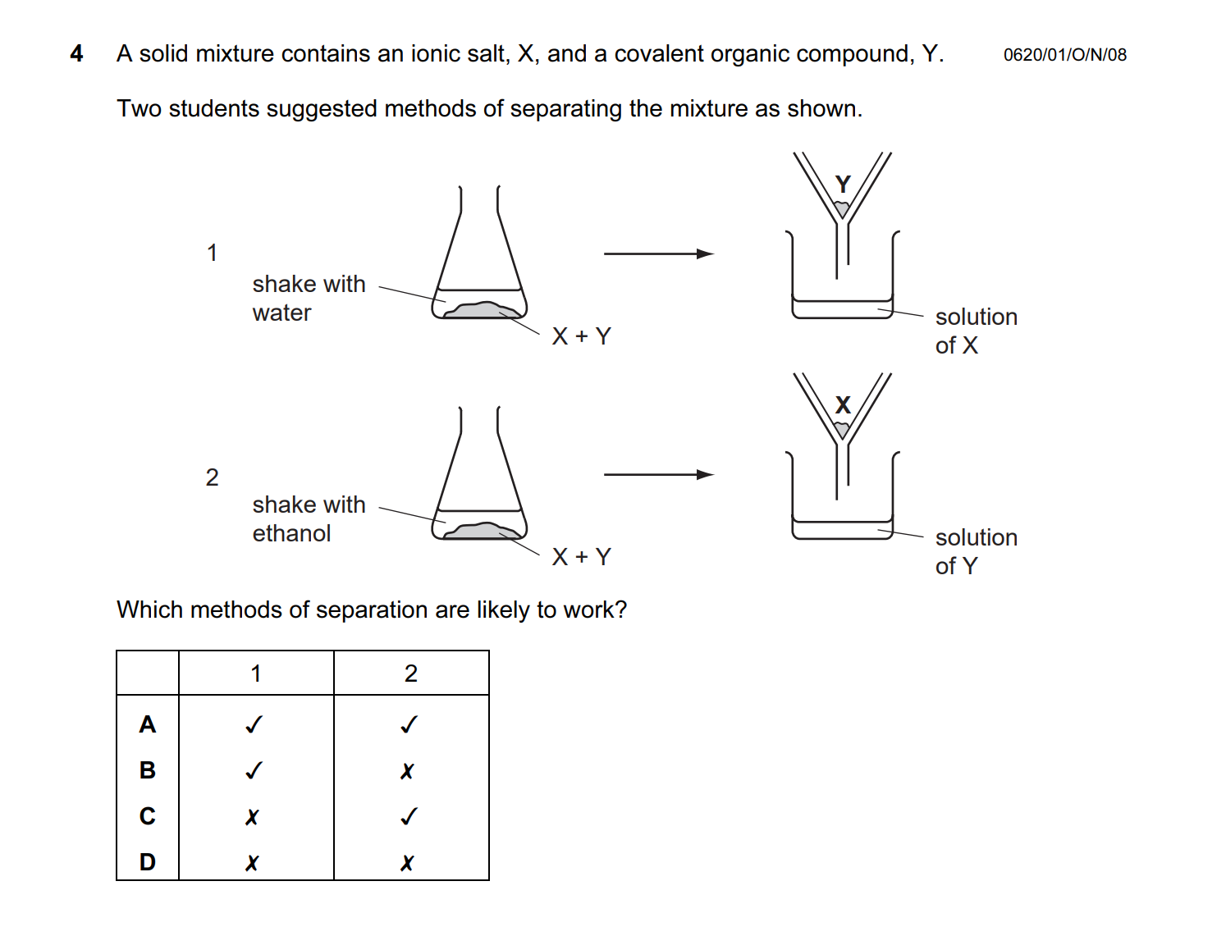


Slide 15
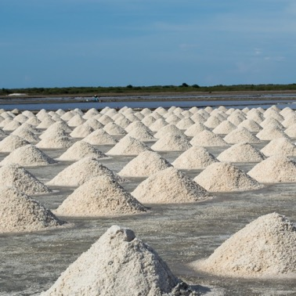
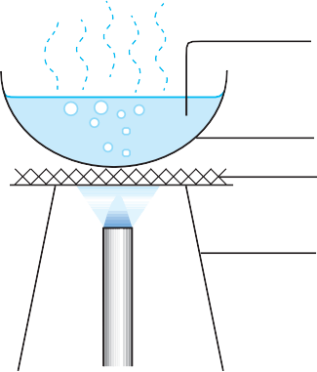
2. Evaporation to dryness
Evaporation to dryness is used to obtain a soluble solid from a solution by heating the solution
until all the water has boiled off.
salt solution
evaporating dish
wire gauze
tripod stand
Evaporation of salt solution
Salt is recovered by evaporation to dryness
from seawater in the rural area of Thailand.
15
Notes:
Quiz students on the definition of evaporation and the purpose of a Bunsen burner.
Relate this to the preparation of salts — obtaining a pure dry sample of a soluble salt (Chapter 12).
Quiz students on the types of salts that can be obtained via evaporation to dryness.

Slide 16
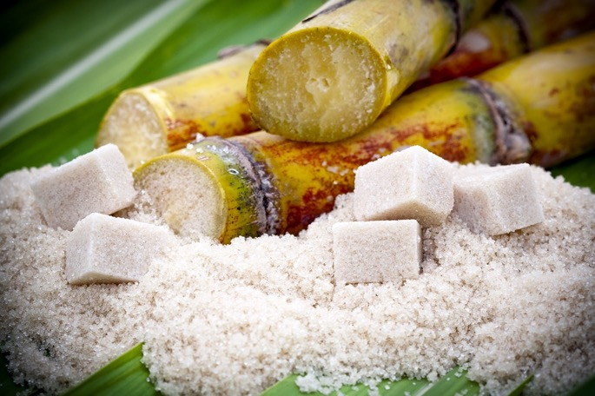
3. Crystallisation
In crystallisation, water is removed by heating the solution. Heating is stopped at the stage when a hot saturated solution is formed. If the resulting solution is allowed to cool to room temperature, the dissolved solid will form as pure crystals.
Sugar is obtained from sugarcane by crystallisation.
16
Notes:
Ask students to recall crystallisation from the topic of Acids and Bases (Chapter 12).
Guide them on how sugar is separated from sugarcane.
Encourage students to answer the quick check in the Student’s Book p. 365.

Slide 17

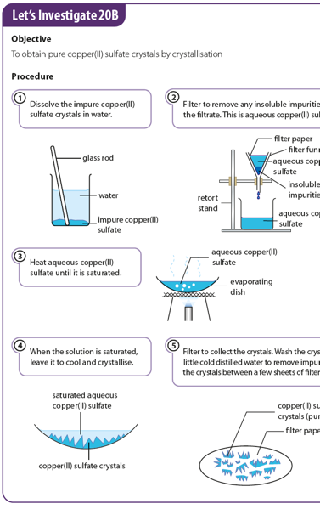
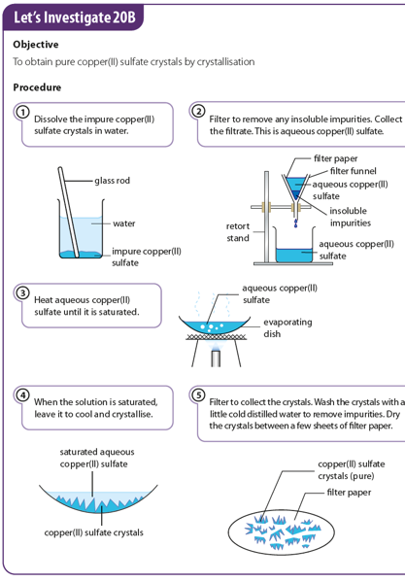
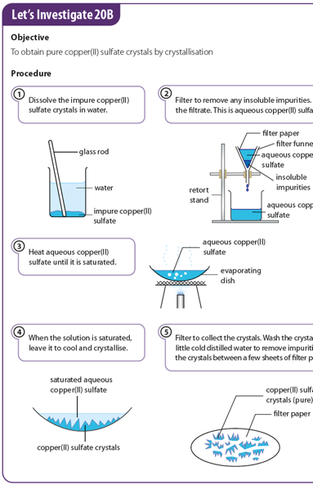
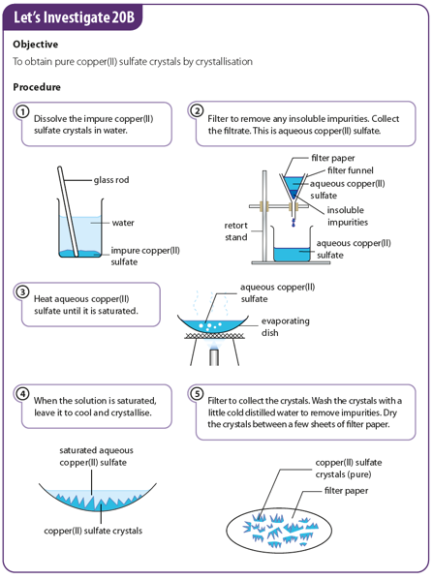
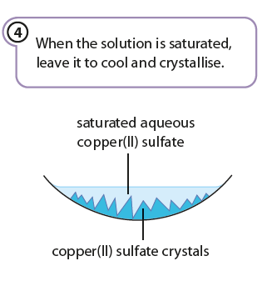


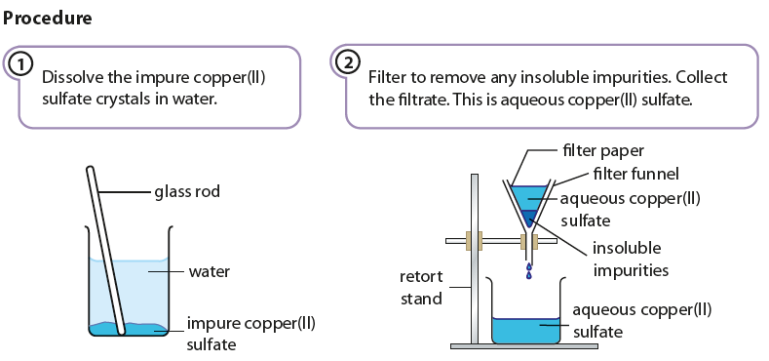
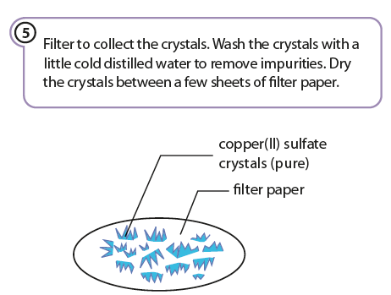
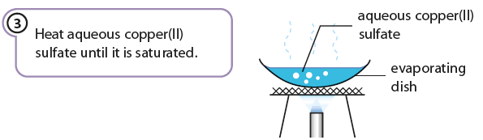
17
Notes:
Guide students on the preparation of pure crystals of copper(II) sulfate from impure copper(II) sulfate solution using Student’s Book p. 366.
Quiz students on the definition of a saturated solution.
Encourage them to suggest the purpose of washing the crystal with cold distilled water.

Slide 18
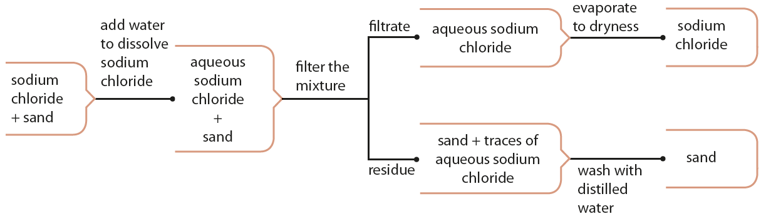
How can we separate solids using a suitable solvent?
Steps taken to separate sodium chloride and sand
18
Notes:
Prompt students on the physical properties of sand and sodium chloride (i.e. sand is insoluble and sodium chloride is soluble in water) to ensure that students plan their separation techniques based on the properties of the substances.
Use the figure to show students that we can combine to types of separation techniques.

Slide 19
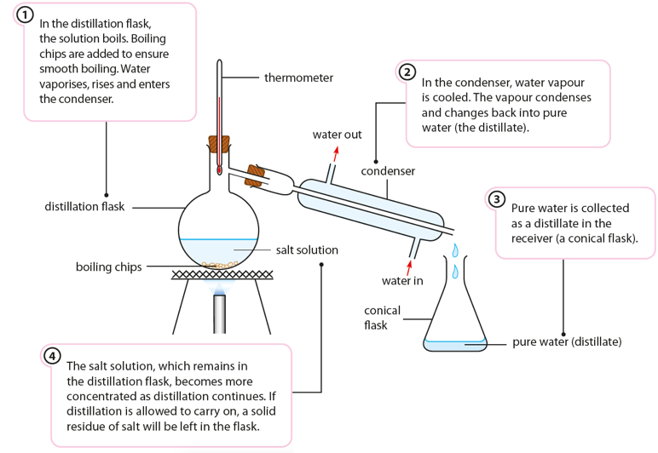
How can we separate a liquid from a solution?
1. Simple distillation
Simple distillation is used to separate a pure solvent from a solution. Distillation is the process of boiling a liquid and condensing the vapour.
Simple distillation to obtain pure water from salt solution
Notes:
Highlight to students that this technique is used to obtain the solvent instead.
Prompt students that this is the opposite of ‘evaporation to dryness’ where the solute is obtained instead of the solvent.
Guide them on the steps to obtain pure water from salt solution via distillation using Student’s Book p. 367.
Go through with students the steps taken during distillation using Table 20.8 in Student’s Book p. 368 and the figure in this slide.
Encourage them to draw a sketch of distillation apparatus.

Slide 21
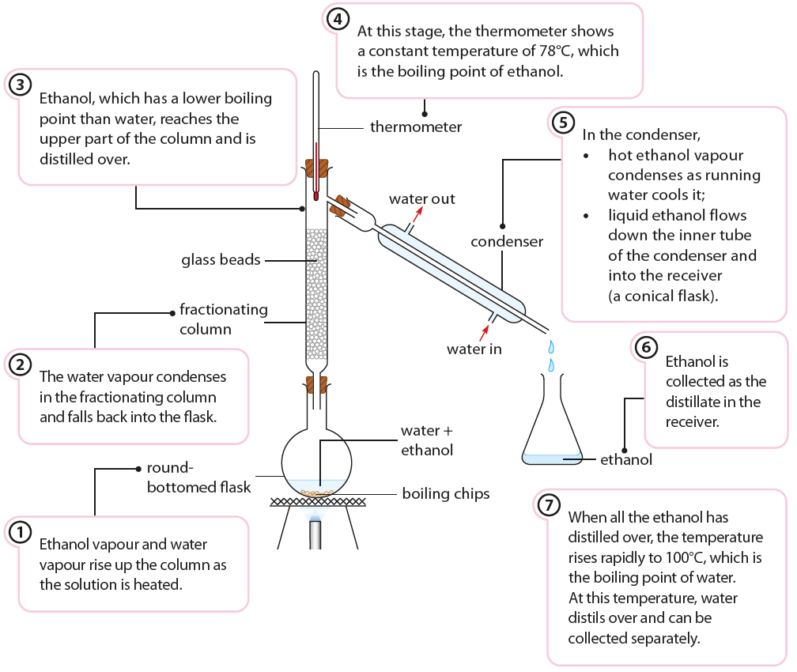
2. Fractional distillation
A mixture that contains two or more liquids with close boiling points can be separated by fractional distillation. Fractional distillation is used to separate a mixture of miscible liquids with different boiling points.
During fractional distillation,
The liquid with the lowest boiling point will distil over first,
The vapours of liquids with higher boiling points condense along the fractionating column and fall back into the round-bottomed flask.
21
Notes:
Highlight to students the difference between fractional distillation and simple distillation.
Compare the terms miscible and soluble. Highlight to students when to use the terms.
3. Using the figure and figure 20.28 in Student’s Book p. 369,
Explain the steps involved in fractional distillation.
State the purpose of the fractionating column, boiling chips, condenser and thermometer in this set-up.
Explain to students that the thermometer measures the boiling point of the substance that is being distilled.
State why a hot water bath is used rather than Bunsen burner when heating a mixture of hydrocarbons.

Slide 22
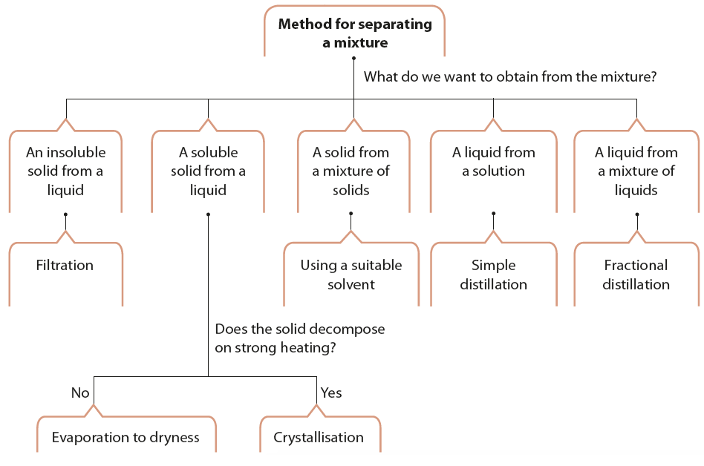
How can we decide on the method to separate a mixture?
Guide for determining the method of separating a mixture
22
Notes:
Guide students on how to decide on the method(s) to separate a mixture.
Encourage students to construct their own mind map .
Have students answer the question in Quick Check on Student’s book p. 369.

Slide 23
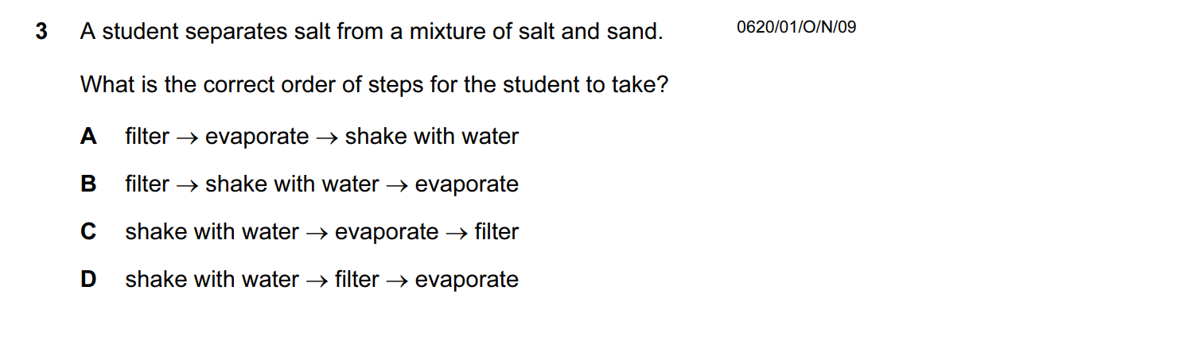

HEHEHEHA

Slide 24
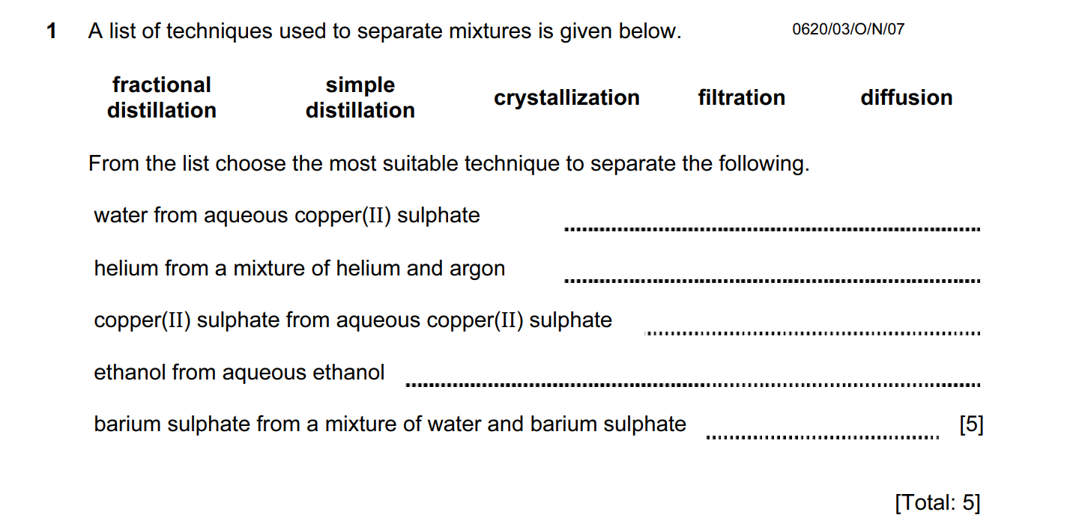


Slide 25
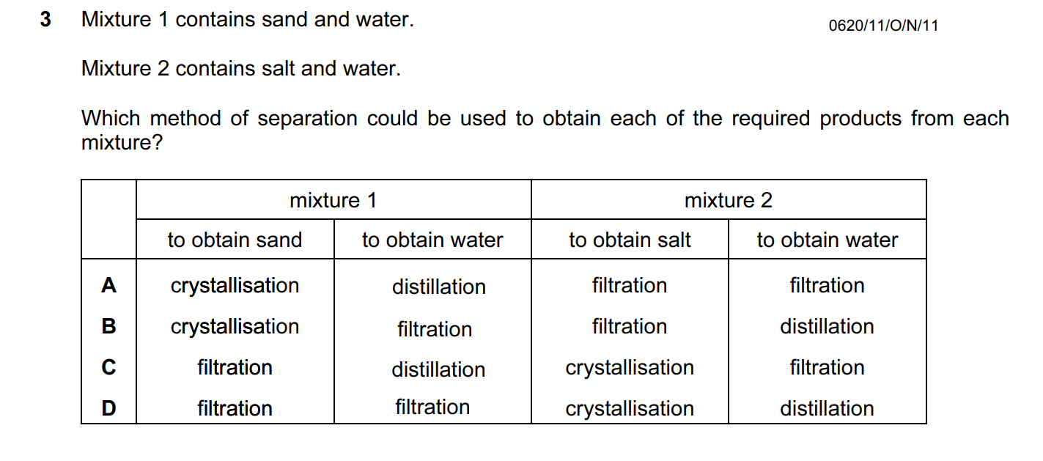


Slide 26
How do the melting and boiling points help identify substances and their purity?
Some examples showing the importance of purity
26
Notes:
Using the figure, show students some examples of the importance of purity.

Slide 27
stirrer
Determining melting point of a substance
A solid is pure if it has an exact and constant (or fixed) melting point.
The melting point of pure benzoic acid is 122°C.
thermometer
What are the effects of impurities on melting point?
melting point tube
rubber band
Impurities lower the melting point of a solid.
  The greater the amount of impurities, the lower the melting point.
Impurities cause melting to take place over a range of temperatures.
  For example, an impure sample of benzoic acid may melt over a temperature range of 118–121°C.
benzoic acid
paraffin oil
heat from electric heater
Experimental-set-up to determine the melting point of benzoic acid
27
Notes:
Guide students on how to determine the melting point of a substance.
Reinforce their understanding and ask them what effect the impurities will have on the melting point.
Use the figure to show them the experimental set-up to determine the melting point of benzoic acid.

Slide 28
Determining boiling point of a substance
Once the sample starts to boil, heating is stopped, and the temperature starts to fall. The temperature at which the liquid sample enters into the capillary tube is the boiling point of the sample. The boiling point of pure methanolic acid is 101°C.
stirrer
thermometer
small test tube
What are the effects of impurities on boiling point?
rubber band
capillary tube
Impurities increase the boiling point of a liquid.
  The greater the amount of impurities, the higher the boiling point.
Impurities cause boiling to take place over a range of temperatures.
paraffin oil
methanoic acid
heat from electric heater
Experimental-set-up to determine the boiling point of methanoic acid
28
Notes:
Guide students on how to determine the boiling point of a substance.
Reinforce their understanding and ask them what effect the impurities will have on the boiling point.
Use the figure to show them the experimental set-up to determine the boiling point of methanoic acid.

Slide 29
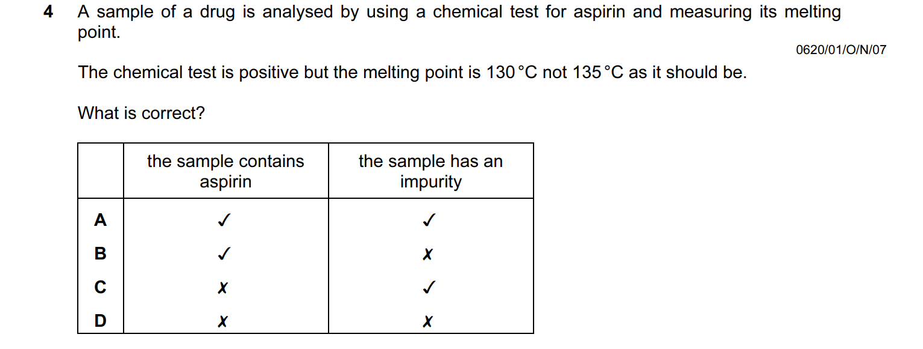


Slide 30
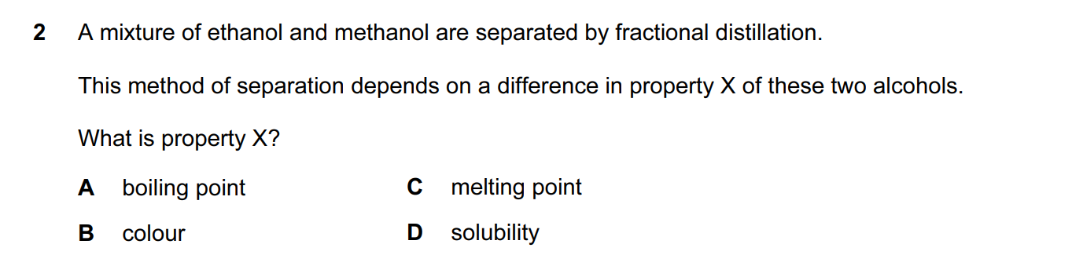

Slide 31
Acknowledgements
Slide 1: chemist – ID 109027403 © Jarun011 | Dreamstime.com, burette © MCE, pipette © MCE
Slide 2: laboratory glassware ID 13577519 © R. Gino Santa Maria Shutterfree, Llc | Dreamstime.com
Slide 4: analogue stopwatch © MCE, digital stopwatch © MCE
Slide 5: temperature sensor © MCE, digital thermometer – ID 181955428 © N. Rotteveel/Dreamstime.com, alcohol thermometer © MCE
Slide 6: electronic balance © MCE
Slide 7: laboratory glassware ID 13577519 © R. Gino Santa Maria Shutterfree, Llc | Dreamstime.com, burette © MCE, pipette © MCE
Slide 14: adding salt to water © MCE, copper sulfate solution © MCE
Slide 15: pouring soft drink in a glass with ice on an isolated white background © Phattharaporn Fongkaew | 123rf.com, glass jug with vinegar on table – ID 131592121 © Chernetskaya | Dreamstime.com, corn field on bright day on background blue sky – ID 108906187 © Serg_velusceac | Dreamstime.com, iodine tincture in a small glass beaker – ID 144042272 © Jatupron Vongta | Dreamstime.com
Slide 16: copper sulfate salt © MCE, coffee – ID 78792720 © Natthapon Ngamnithiporn | Dreamstime.com
Slide 18: pipette filler © Jérôme (https://commons.wikimedia.org/wiki/File:Propipette-et-pipette.jpg)/ CC BY-SA 3.0 (https://creativecommons.org/licenses/by-sa/3.0/deed.en)
Slide 21: pouring breakfast – ID 12002677 © Ericlefrancais | Dreamstime.com
Slide 23: thumbprint and magnifying glass © MCE
Slide 27: salt pans – ID 125712709 © Srisakorn Wonglakorn/Dreamstime.com
Slide 28: cut sugarcane plants – ID 13162268 © Grondin Franck Olivier | Dreamstime.com
Slide 34: tablet © MCE, medicine – ID 68674547 © (null) | Dreamstime.com, cupcakes – ID 49315796 © Ruth Black | Dreamstime.com
Slide 43: solutions and precipitates © MCE
Slide 45: Performing a calcium flame test © DAVID TAYLOR | Science Photo Library, flame test sequence © SCIENCE PHOTO LIBRARY
31

